Slide 1
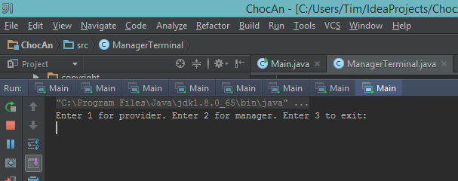
ChocAn User Interface Software
By: Timmethy Tran

Slide 2
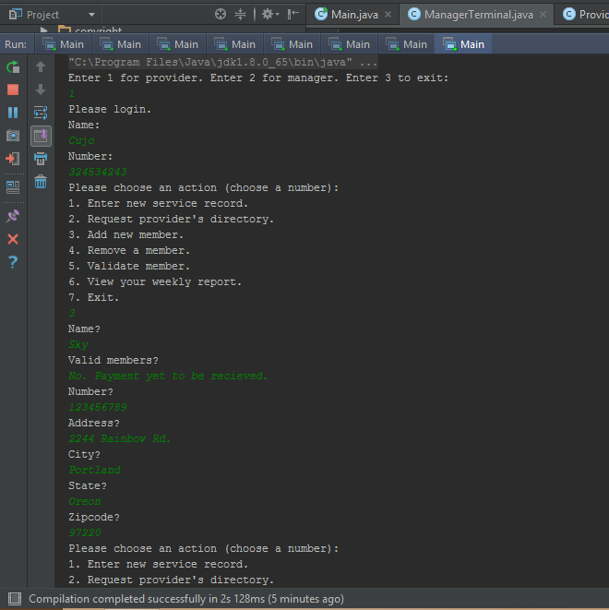
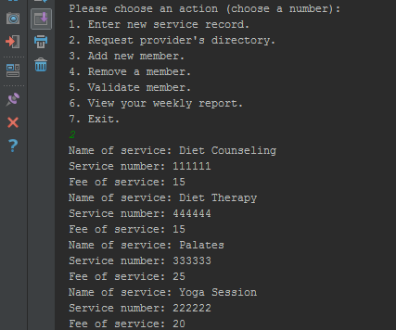
Adding providers/members
Members are added manually
A test file with members has been provided for testing
Picture shows process of logging in and adding.
List of services can also be displayed for ease of use

Slide 3
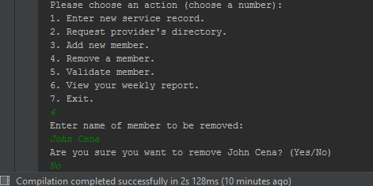
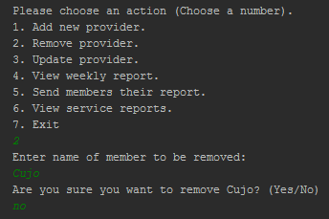
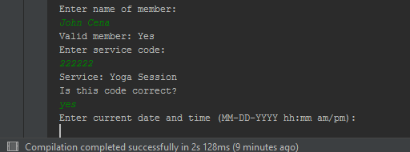
Checks and Balances
Has a series of checks to prevent errors
Important activities require you to double check, like removing members or providers.
Errors also come with checks to retry or not.
How much of the code was tested. Using checks

Slide 4
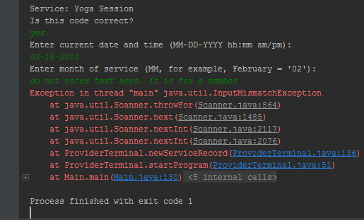
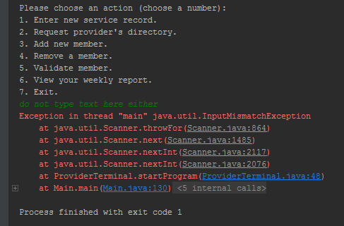
Things to not do
Follow instructions and you will avoid error
Enter text where numbers are asked, and vice versa
Some areas have been tested against this and can be fixed after software shows a warning message
Not all areas have the same precautions however.

